Slide 1
Multi Model, NLP Generated Instructional Slides For Educational Use
By: Aamr Ibrahim , Nathan Sage , Vinay Chintakayala

Slide 2
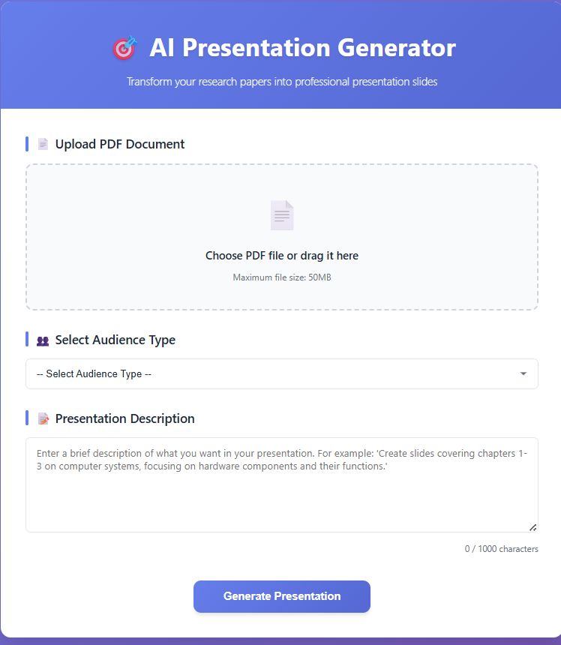
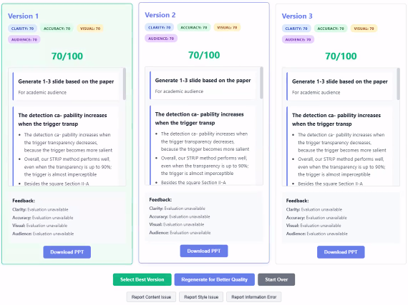
Input Critic in the loop
Final Output

Slide 3
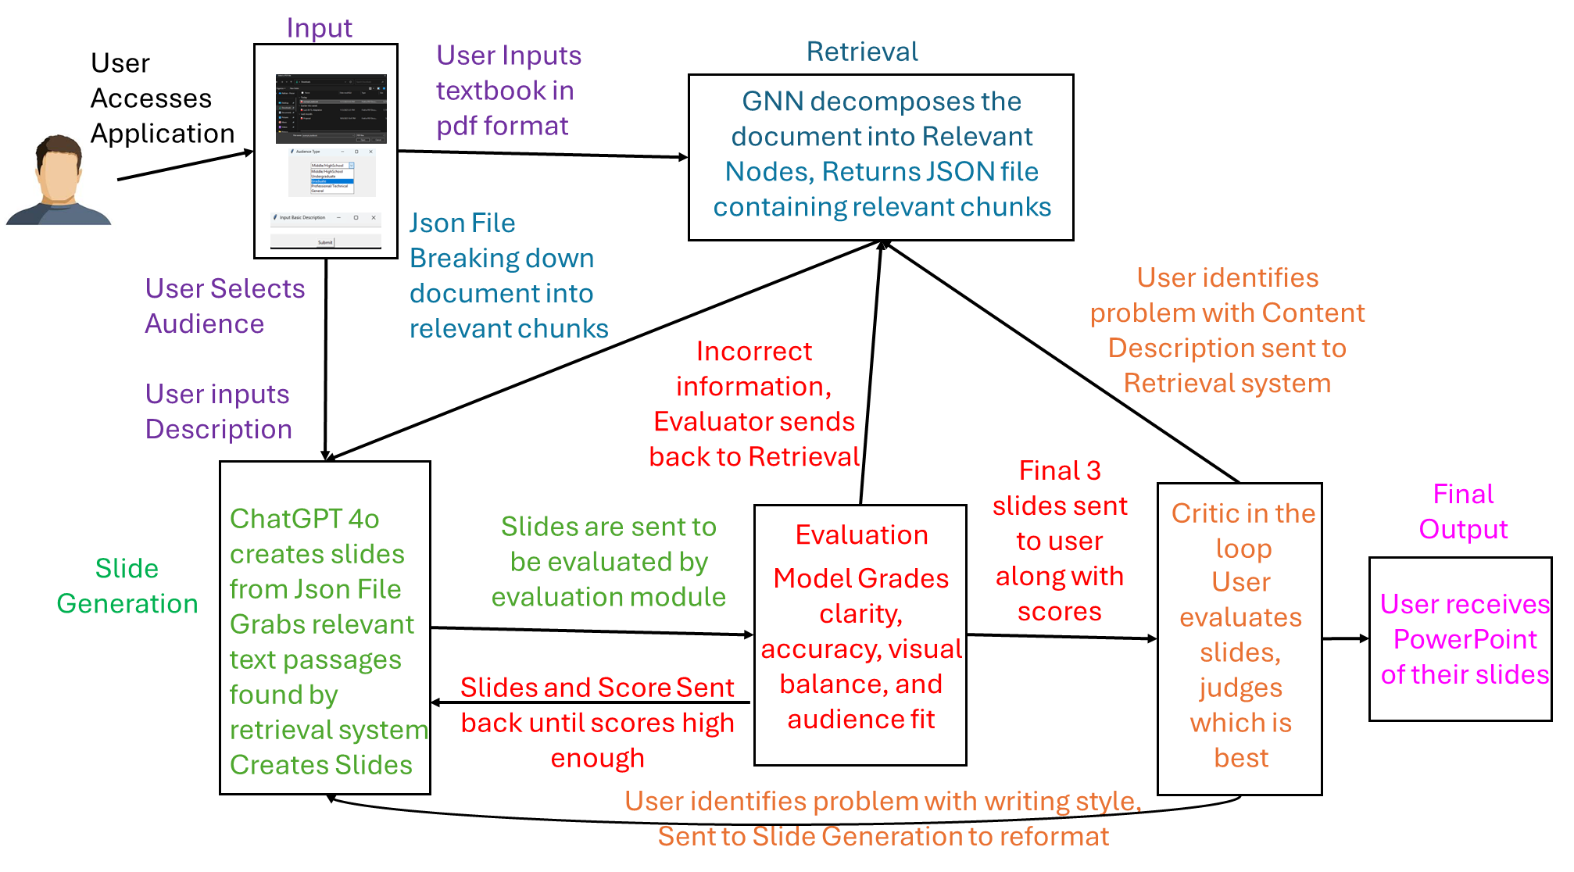

Slide 4
Retrieval
Using a GNN
PDF is broken down into relevant chunks
  Chapters
  Sections
  Paragraphs
  Significant sentences
Construct a graph with nodes representing units and edges in relations
Edges capture semantic and structural relationships:
  Sequential (section order),
  Hierarchical (chapter–section),
  Semantic (embedding similarity or co-reference),
  Visual (figure–caption linkage).
Using the edges, Nodes will train the GNN to discriminate highly related and unrelated sections
Finally it Obtains the most pertinent sections for every slide

Slide 5
Model/Generator
Model receives information from User description and GNN
Creates slides based on trained information from its knowledge base
Eliminates any noisy or unnecessary content that the GNN might have retrieved.
Creates generated slides.
Creates several slide variations that can be compared using the evaluation model.
Sends links from the GNN to be evaluated by the evaluation model

Slide 6
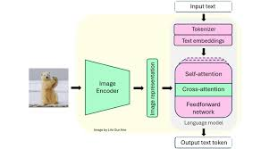
Evaluation Module
VLMS
To guarantee readability and clarity, VLMs examine the output slides' text content as well as their visual arrangement (design, alignment, colors).
Identify inconsistencies between the text and the visualizations
Analyzes the links from the GNN to ensure data is not hallucinated
Offer a scoring system that compares multiple presentation versions to select the most effective and coherent one.

Slide 7
Critic In The Loop
User is presented with 3 generated PowerPoint decks.
The User selects the best version based on content and presentation quality.
  After selecting, the system prompts the user with an option to “Regenerate Slide.”
If the problem is with content:
  System routes back to the Retrieval (GNN) module to fetch more relevant information.
If the problem is with writing or design:
  System routes back to the Generation module for rewriting or reformatting.
If the user is satisfied:
  Proceeds to move forward to the Final Output.

Slide 8
Implementation Details
REST endpoints for every stage of the workflow are exposed through a Flask based REST API.
Retrieval, generation, and evaluation are distinct, independently testable modules in a modular design.
Sequential processing from user input through retrieval, generation, evaluation, and final output is known as a multi-stage pipeline.
Feedback loops: Refinement at various stages is possible with multiple correction points.
Critic-in-the-loop: Examine the interface to compare iterations, offer comments, and choose the best result.
Independent development: Every component is created, evaluated, and enhanced independently of the others.
Inbuilt evaluation stage that checks the quality of slides before final delivery.
User oversight: Reviewers may view, compare, and give feedback on several slide variants.
Independent development: each component can be developed, tested, and improved without interference to other components.

Slide 9
GNN
The GNN/Retrieval Module is responsible for finding the most relevant parts of a PDF before slide generation begins.
  Start by extracting text from the PDF using pdfplumber
  Break the document into chunks of around 500 words, with a small 3-word overlap to maintain continuity.
To model relationships between these chunks, we build a graph where each chunk becomes a node.
Edges are created based on how similar the chunks are
  Semantic Similarity from sentence transformer embeddings and Keyword overlap
Apply a similarity threshold of 0.5 to filter unnecessary edges
For retrieval, we use MiniLM-L6-v2 embeddings to run semantic search.
Using the description and intended audience, the system retrieves the 20 most relevant chunks
The module returns a structured JSON output containing the graph (nodes and edges) along with the most important chunks that will be passed to the slide generation stage.

Slide 10
Slide Generator
Google’s Gemini API (gemini-1.5-pro model)
  Create high-quality slide drafts
  Since the API only allows six calls per session
  Fallback system that automatically takes over once the Limit is reached.
The model generates three different slide versions, giving users multiple choices to review and select from
Using the structured JSON from the GNN, allows the model to directly reference the most relevant document chunks.
We configure Gemini with a temperature of 0.7 and allow up to 4000 tokens per response to balance creativity and clarity.
If the API fails, the fallback module produces basic slides using only the retrieved content, ensuring there will always be an output.

Slide 11
Evaluation System
Uses Google Gemini API (gemini-1.5-pro model)
  API call limit: 6 calls per session (with default evaluation after limit)
Evaluates 4 criteria (0-100 scale):
  Clarity: language clarity, structure, organization
  Accuracy: factual correctness, source alignment
  Visual Balance: content distribution, layout
  Audience Fit: language appropriateness, complexity
Provides feedback, strengths, weaknesses, and recommendations
Temperature: 0.3, max tokens: 2000
Uses a default evaluator when the API unavailable

Slide 12
Results…

Slide 13
References
Retrieval
https://aclanthology.org/2024.findings-emnlp.936/
VLM SlideEval
https://openreview.net/pdf?id=DRACd7p5ur
Basic Idea
https://proceedings.mlr.press/v264/xie25a.html
Persona (model)
https://aclanthology.org/2024.eacl-long.163/
AI Tool usage
https://openreview.net/pdf?id=GrkgKtOjaH

